Slide 1

SRI HARI DEGREE COLLEGE
(Permanently Affiliated to Yogi Vemana University, Kadapa)
Recognized by UGC New-Delhi under Section 2(f) &12(8)
An ISO 9001:2015Certified Institution
#45/290-10,BalajiNagar,Kadapa,A.P.,INDIA-516003
E-Mail:sriharidc047@gmail.com Web: www.sriharidegreecollege.ac.in ©9440074132
prepared
by
DR.V.SUBBAREDDY (H.O.D)
Dept.of Mathematical Sciences

Slide 2
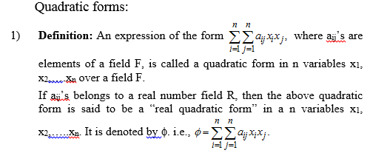


Slide 3



Slide 4
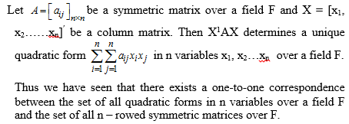



Slide 5
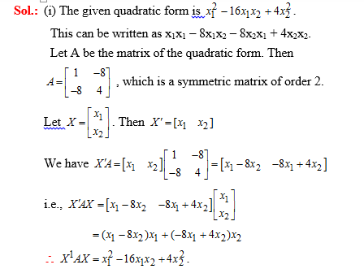

Slide 6

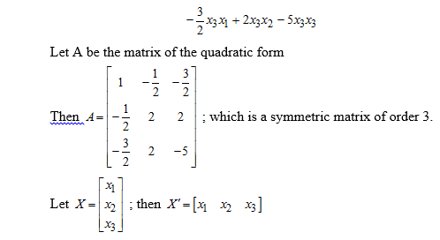

Slide 7
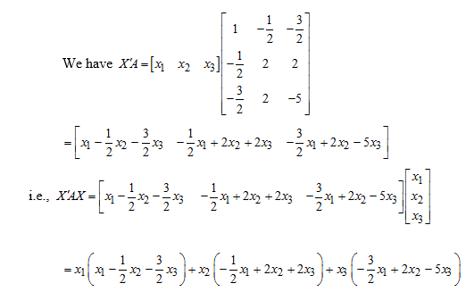

Slide 8


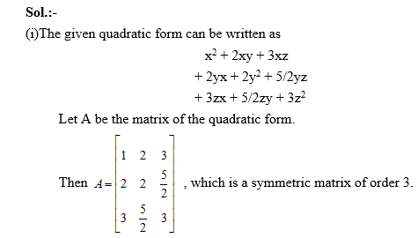

Slide 9
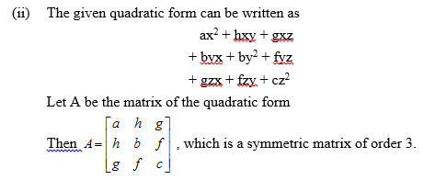
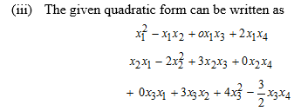

Slide 10

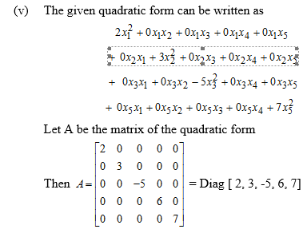

Slide 11

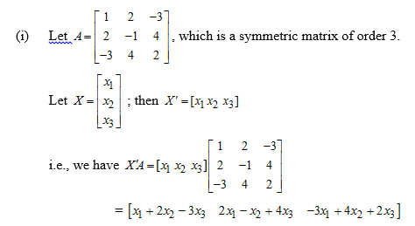

Slide 12


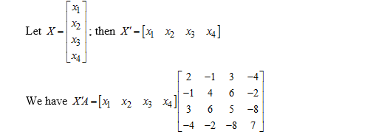

Slide 13



Slide 14

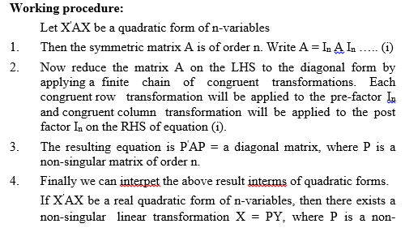

Slide 15




Slide 16
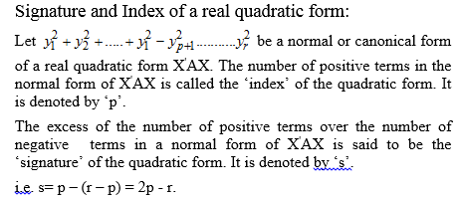



Slide 17

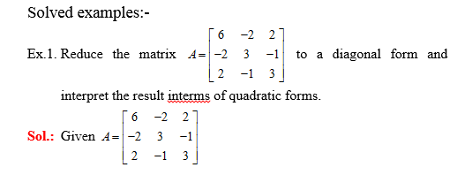

Slide 18
